Slide 1
Office of Community Accountability
Professional Standards Unit
Lt. Shawn Hill

Slide 2
Objectives
Short History of POBRA
Complaint Process
Anatomy of an Investigation

Slide 3
Public Safety Officers Bill of Rights Act
Goes by many names: AB 301, POBAR, etc.
Introduced in 1974, effective 1977
Early Conception from LAPD Police Protective League and Peace Officer Research Association of California (PORAC)
ACLU was one of the larger supporters of the Act
The Act was an attempt to rectify gross abuses of power by the internal investigative departments of LAPD

Slide 4
Legal Codes
POBRA is primarily covered under California Government Code 3300-3312

Slide 5
The Intersection Between POBRA and Internal Investigations
Most of the laws required under POBRA relate to how the officer interviews are conducted:
Right to representation
Reasonable hour
Informed of their constitutional rights (for offenses that may be criminal)
Informed of the nature of the investigation prior to interrogation
Shall not be subjected to any punitive action for exercising their rights
No more than two interrogators at one time
Not subjected to offensive language, etc.

Slide 6
How does our Department receive complaints
Can meet with the Watch Commander or Supervisor in person
Available online (smart phone compatible)
Forms available in the PD lobby
Can make complaints over the phone
Can make anonymous complaints
Receive complaints by mail
Internally generated (observed by employee or supervisor)

Slide 7
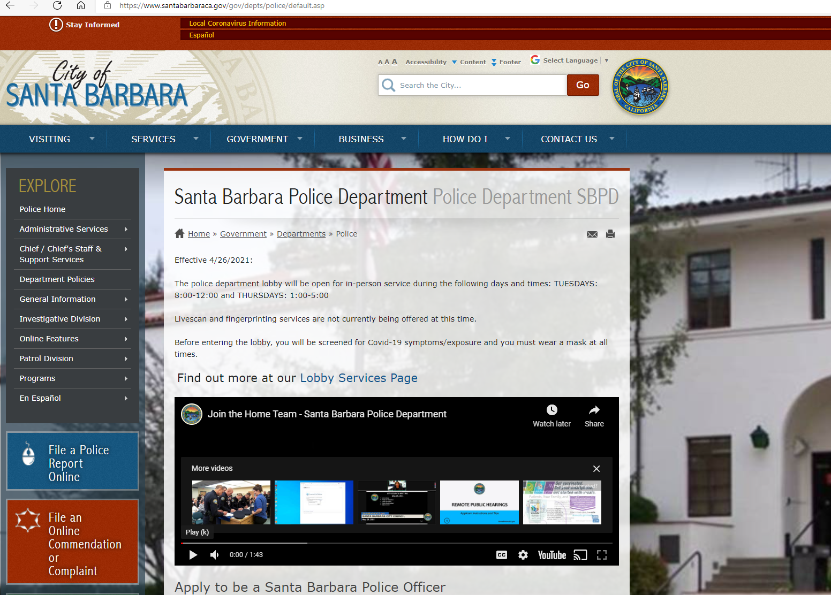
Online Complaints

Slide 8
The Process of an Investigation
Incoming complaint
Internal (employee)
External (community member)
Reviewed by Community Accountability for determination of process
Remain in PSU or assigned to Division supervisor
Investigation completed (required within one year)
Forwarded to employee’s manager for recommended finding and discipline
Forwarded to Division Commander who makes finding and determines discipline
Chief conducts Skelly hearing if requested
Returned to PSU for filing

Slide 9
Anatomy of an Investigation
Assigned to an investigator
Review the complaint
Identify potential policy violations (or lack thereof)
Identify potential criminal violations (or lack thereof)
If yes, separate criminal investigation is initiated
Most often contact the complaining party for follow up questions and to share contact info.
Identify and collect potential evidence (MAV recording, private video, reports, etc.)
Identify and interview potential witnesses (recorded and saved)
Interview subject officer(s)
Write reports on investigation
Complete Investigation reviewed by Community Accountability Lieutenant (who oversees PSU)

Slide 10
Anatomy of an Investigation (cont’d)
Forwarded to Manager of employee (lieutenant or professional staff manager)
Manager reviews and makes recommendations for finding and discipline (if applicable)
Forwarded to Captain for findings and discipline (if applicable)
Captain notifies subject employee of finding
Skelly hearing if requested by employee
Discipline or Training implemented
Returned to PSU for filing
Complainant notified of result

Slide 11
Findings
Not sustained- When the investigation discloses that there is insufficient evidence to sustain the complaint or fully exonerate the employee.
Unfounded- When the investigation discloses that the alleged acts did not occur or did not involve department members. Complaints that are determined to be frivolous will fall within the classification of unfounded (Penal Code § 832.8).
Exonerated- When the investigation discloses that the alleged act occurred but that the act was justified, lawful and/or proper.
Sustained- A final determination that the actions of an employee were found to violate law or department policy.

Slide 12
PC 832.7 makes PSU investigations confidential, except:
Discharge of a firearm at a person
Use of force resulting in great bodily injury or death
Sustained finding of sexual assault
Sustained finding of dishonesty
Notes:
Great Bodily Injury: “Significant or substantial injury”

Slide 13
Questions?

